Slide 1

Gaming Data with Twich
Analyze Data with SQL
Paulina Kossowska
April 2021

Slide 2
Twitch is the world’s leading live streaming platform for gamers, with 15 million daily active users. Using data to understand its users and products is one of the main responsibilities of the Twitch Science Team.
In this project, you will be working with two tables that contain Twitch users’ stream viewing data and chat room usage data.

Slide 3
TASK 1.1
I'll looking inside this two tables.
SELECT *
FROM stream
LIMIT 10;
SELECT *
FROM chat
LIMIT 10;

Slide 4
TASK 1.2
stream table
time | device_id | login | channel | country | player | game | stream_format | subscriber
01.01.2015 18:33 | 40ffc2fa6534cf760becbdbf5311e31ad069e46e | 085c1eb7b587bfe654f0df7b4ba7f4fc4013636c | frank | US | iphone_t | League of Legends
01.01.2015 23:35 | 9a8cc2b7162b99c0a0f501dc9a5ec4f68586a760 | 5ad49a7b408ce452140b180dd6efb57a9f4d22c7 | george | US | site | DayZ | chunked | FALSE
01.01.2015 04:39 | 2f9c3f9ee1033b71a3819564243f20ef3bec0183 | 5b9a43e68f019185f55615d0b83019dee4b5d06f | frank | US | site | League of Legends | chunked | FALSE
01.01.2015 11:15 | 0cda8226ba2583424c80c3c1c22c1256b080ad17 | 02c7797faa4d8a3ff4b0c14ee1764b6817b53d0b | estelle | CH | site | Dota 2 | high | FALSE
01.01.2015 11:28 | e3288ca5e3153aa85e32f64cdd994b7666968dcf | b920c228acbcbebee26d9c79f6eb73b73a9480c7 | morty | FR | site | Heroes of the Storm | medium | FALSE
01.01.2015 23:27 | 343fe2bfd58595d5c18602d420ecf6f9d694d5a8 | 7814f661a54349ff5eee84f9d6f476918c9b7270 | george | US | iphone_t | DayZ
01.01.2015 21:09 | 80a0c7d1abb6a5a0060e18202b77bef831e08ca5 | eb158cab3f606d3894a32e20bddbfd2d589095a9 | frank | US | site | League of Legends | high | TRUE
01.01.2015 19:14 | 1e342e5e4e228f617449029054b3bb19c5224528 | 2aaf6a414bc3dc923b04f986de7ba1b8101c6698 | frank | CA | site | League of Legends | high | FALSE
01.01.2015 13:51 | 272cffbb1a9a33ad3bb48a2ee9ae5cbcac5ca22e | 401716920e3435b5e3eec9fc4ccd6a44c7af38f5 | kramer | TR | site | Counter-Strike: Global Offensive | chunked | FALSE
01.01.2015 22:00 | 593ed161c456eeeb9e18b8005786d42abc1a7373 | ef24dc49ceb4bcd3cccb0fa862d8a150ecf935e1 | frank | US | site | League of Legends | medium | FALSE

Slide 5
TASK 1
chat table
time | device_id | login | channel | country | player | game
01.01.2015 18:45 | 70e2b95b5ac0d4c227e46966658d16b3e044996e | 5c2f5c1f19a7738e16ed0be551d865e8a8fce71d | jerry | BY |  | Dota 2
01.01.2015 01:16 | f2b9065b55fd80d6aa653ce989b489f4ec5198be | 0d77740e4fb5ce77d94f9f6c8ef1f762990d0344 | elaine | HK |  | Devil May Cry 4: Special Edition
01.01.2015 16:22 | d448ba963d7e1023dd1b0a40b95d4f6611750692 | 77ab14c1fb815e1c369ba0cf7d4c56b4fe489997 | frank | GB | iphone_t | League of Legends
01.01.2015 03:58 | 8d6823dc52b400b50aebf269bf1f03a36d19eeaa | 91cb88c0743761589273fc5e800e7743ece46494 | frank | US | iphone_t | League of Legends
01.01.2015 11:47 | 16c1e39594d62358d27ae604ad43a071f0d86bc4 | 51a9234f83d656607cfd7f26690c12d2ffbce353 | estelle | DE |  | Dota 2
01.01.2015 17:59 | 6fcc75522de37833a0fb21fba4965aad3b63ea57 | f628d1cb946ea2e8cffc0b327bc9d77775b8d3c0 | jerry | RU |  | Dota 2
01.01.2015 02:24 | dea94b3030025d837dd841fbfd479e775987f65d | 9dbbcf6c7792074771c4c7284807041eac467ad5 | elaine | TW |  | Gaming Talk Shows
01.01.2015 18:26 | 671bee0f3d66077876d9bc231990597292392cc2 | 51c286a41daa8e060275f622f2b8436bee9fab91 | jerry | UA |  | Dota 2
01.01.2015 13:13 | 8b31d5ebd1f4f41d4365ae4a471c1686dd256745 | 06decad1d9565150791e183da017f47123433a4c | estelle | GB | ipad_t | Dota 2

Slide 6
TASK 2
What are the unique game’s in the stream table?
SELECT DISTINCT game
FROM stream;
game
League of Legends
DayZ
Dota 2
Heroes of the Storm
Counter-Strike: Global Offensive
Hearthstone: Heroes of Warcraft
The Binding of Isaac: Rebirth
Agar.io
Gaming Talk Shows
Nan
Rocket League
World of Tanks
ARK: Survival Evolved
SpeedRunners
Breaking Point
Duck Game
Devil May Cry 4: Special Edition
Block N Load
Fallout 3
Batman: Arkham Knight

Slide 7
TASK 3
What are the unique channel’s in the stream table?
SELECT DISTINCT channel
FROM stream;
channel
frank
george
estelle
morty
kramer
jerry
helen
newman
elaine
susan

Slide 8
TASK 4.1
What are the most popular games in the stream table?
SELECT game, COUNT(*)
FROM stream
GROUP BY game
ORDER BY COUNT(*) DESC;
game | COUNT(*)
League of Legends | 1070
Dota 2 | 472
Counter-Strike: Global Offensive | 302
DayZ | 239
Heroes of the Storm | 210
The Binding of Isaac: Rebirth | 171
Gaming Talk Shows | 170
Hearthstone: Heroes of Warcraft | 90
World of Tanks | 86
Agar.io | 71
Rocket League | 49
SpeedRunners | 20
ARK: Survival Evolved | 19
Nan | 15
Duck Game | 5
Fallout 3 | 3
Batman: Arkham Knight | 3
Breaking Point | 2
Block N Load | 2
Devil May Cry 4: Special Edition | 1

Slide 9
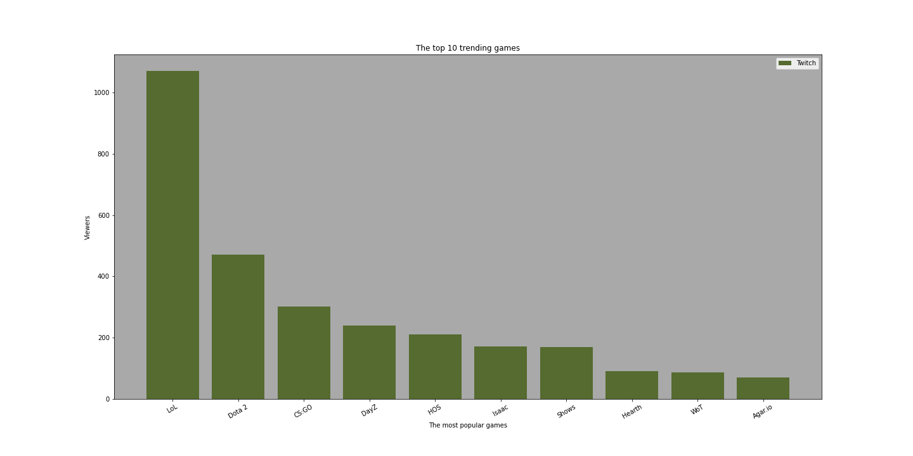
TASK 4.2

Slide 10
TASK 5.1
These are some big numbers from the game League of Legends (also known as LoL).
Where are these LoL stream viewers located?
SELECT country, COUNT(*)
FROM stream
WHERE game = 'League of Legends'
GROUP BY country
ORDER BY COUNT(*) DESC
LIMIT 10;
country | COUNT(*)
US | 447
DE | 66
CA | 64
Nan | 49
GB | 45
TR | 28
BR | 25
DK | 20
PL | 19
NL | 17

Slide 11
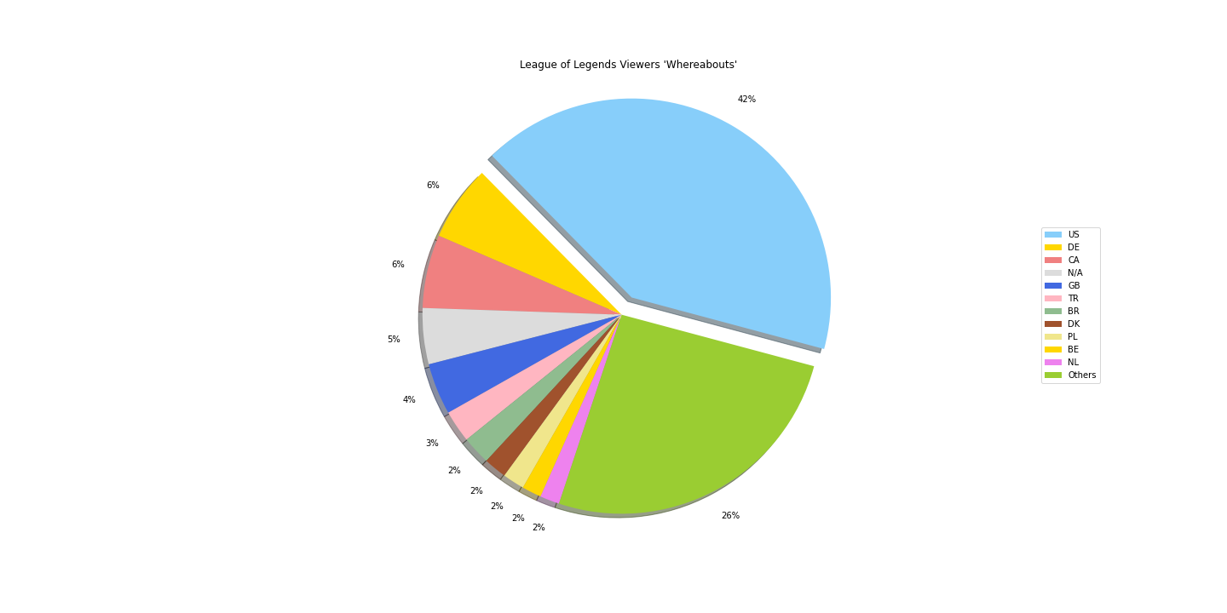
TASK 5.2

Slide 12
TASK 6
The player column contains the source the user is using to view the stream (site, iphone, android, etc).
Create a list of players and their number of streamers.
SELECT player, COUNT(*)
FROM stream
GROUP BY player
ORDER BY COUNT(*) DESC;
player | COUNT(*)
site | 1365
iphone_t | 622
android | 547
ipad_t | 290
embed | 125
xbox_one | 22
home | 16
amazon | 6
frontpage | 4
xbox360 | 1
roku | 1
chromecast | 1

Slide 13
TASK 7.1
I’ll create a new column named genre for each of the games.
Group the games into their genres: Multiplayer Online Battle Arena (MOBA), First Person Shooter (FPS), Survival, and Other.
Using CASE, your logic should be:
If League of Legends → MOBA
If Dota 2 → MOBA
If Heroes of the Storm → MOBA
If Counter-Strike: Global Offensive → FPS
If DayZ → Survival
If ARK: Survival Evolved → Survival
Else → Other
SELECT game,
CASE
WHEN game = 'League of Legends'
THEN 'MOBA'
WHEN game = 'Dota 2'
THEN 'MOBA'
WHEN game = 'Heroes of the Storm'
THEN 'MOBA'
WHEN game = 'Counter-Strike: Global Offensive'
THEN 'FPS'
WHEN game = 'DayZ'
THEN 'Survival'
WHEN game = 'ARK: Survival Evolved'
THEN 'Survival'
ELSE 'Other'
END AS 'genre',
COUNT(*)
FROM stream
GROUP BY game
ORDER BY COUNT(*) DESC;

Slide 14
TASK 7.2
game | genre | COUNT(*)
League of Legends | MOBA | 1070
Dota 2 | MOBA | 472
Counter-Strike: Global Offensive | FPS | 302
DayZ | Survival | 239
Heroes of the Storm | MOBA | 210
The Binding of Isaac: Rebirth | Other | 171
Gaming Talk Shows | Other | 170
Hearthstone: Heroes of Warcraft | Other | 90
World of Tanks | Other | 86
Agar.io | Other | 71
Rocket League | Other | 49
SpeedRunners | Other | 20
ARK: Survival Evolved | Survival | 19
 | Other | 15
Duck Game | Other | 5
Fallout 3 | Other | 3
Batman: Arkham Knight | Other | 3
Breaking Point | Other | 2
Block N Load | Other | 2
Devil May Cry 4: Special Edition | Other | 1

Slide 15
TASK 8
The player column contains the source the user is using to view the stream (site, iphone, android, etc).
Create a list of players and their number of streamers.
SELECT player, COUNT(*)
FROM stream
GROUP BY player
ORDER BY COUNT(*) DESC;
player | COUNT(*)
site | 1365
iphone_t | 622
android | 547
ipad_t | 290
embed | 125
xbox_one | 22
home | 16
amazon | 6
frontpage | 4
xbox360 | 1
roku | 1
chromecast | 1

Slide 16
TASK 9.1
I’ll write a query that returns two columns:
The hours of the time column
The view count for each hour
SELECT strftime('%H', time),
COUNT(*)
FROM stream
WHERE country = 'GB'
GROUP BY 1;
strftime('%H', time) | COUNT(*)
0 | 1
1 | 4
2 | 8
3 | 11
4 | 3
5 | 1
6 | 1
8 | 1
9 | 1
10 | 2
11 | 12
12 | 15
13 | 17
14 | 21
15 | 17
16 | 14
17 | 8
18 | 2
19 | 5
20 | 5
21 | 2
22 | 2

Slide 17
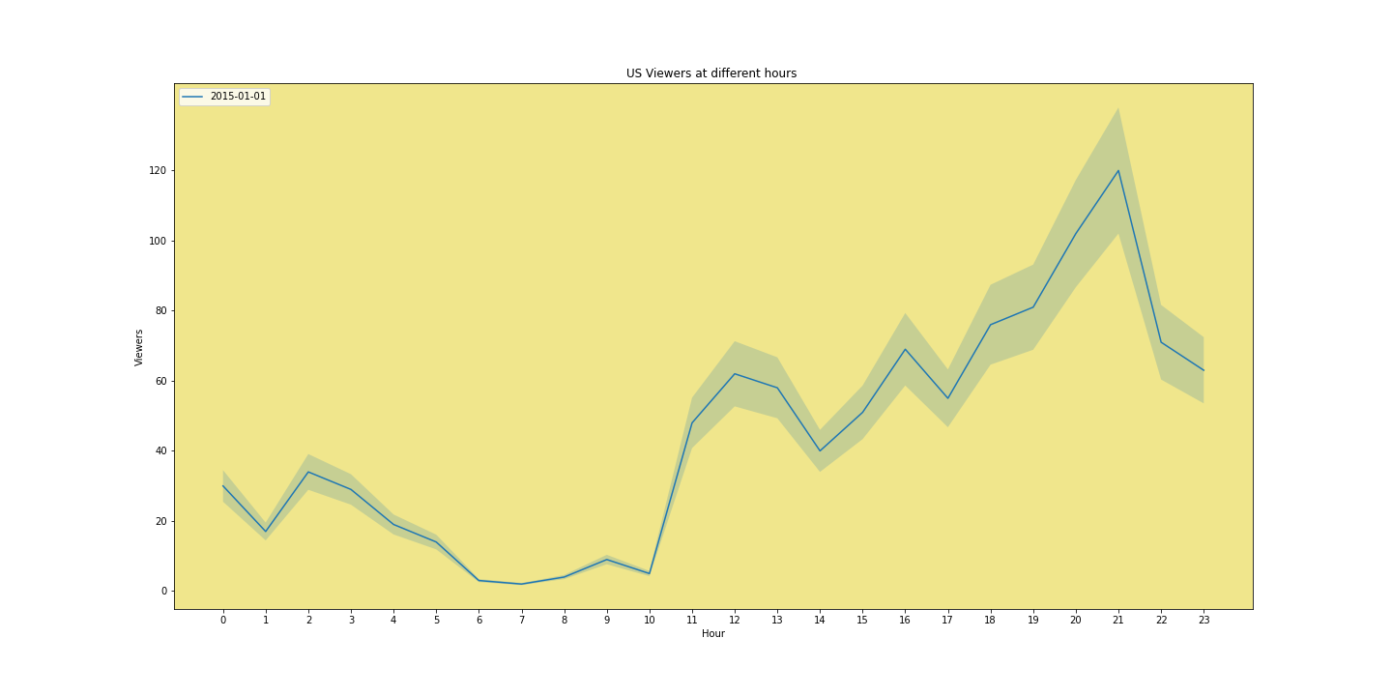
TASK 9.2

Slide 18
Thanks for attention

